Slide 1
__L1n__w@tch
Fifteen Quiz

Slide 2
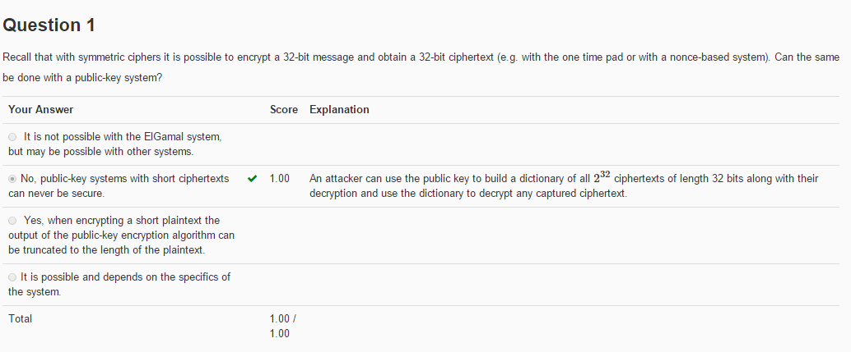
Question 1
解析：
对称加密系统由于密钥未知，所以行。但是公钥加密系统是使用公钥加密，而公钥又是已知的，所以如果密文短，则攻击者可以枚举明文的每一位然后自己用公钥加密，加密结果与密文一致则可知道明文了。

Slide 3
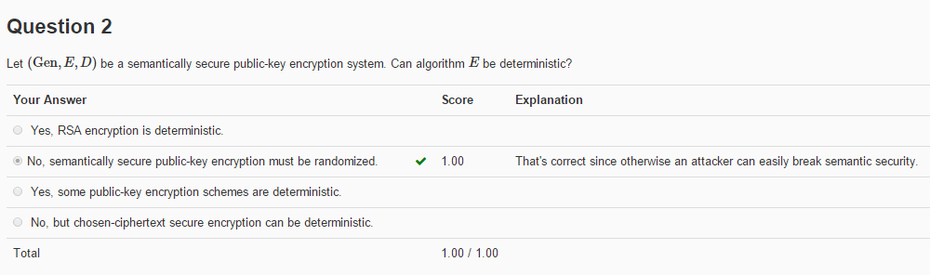
Question 2
解析：
要使公钥加密系统是语义安全的，则要求加密算法E不能是确定性加密（详看11-2）。公钥加密系统语义安全要求选择密文攻击下安全。

Slide 4
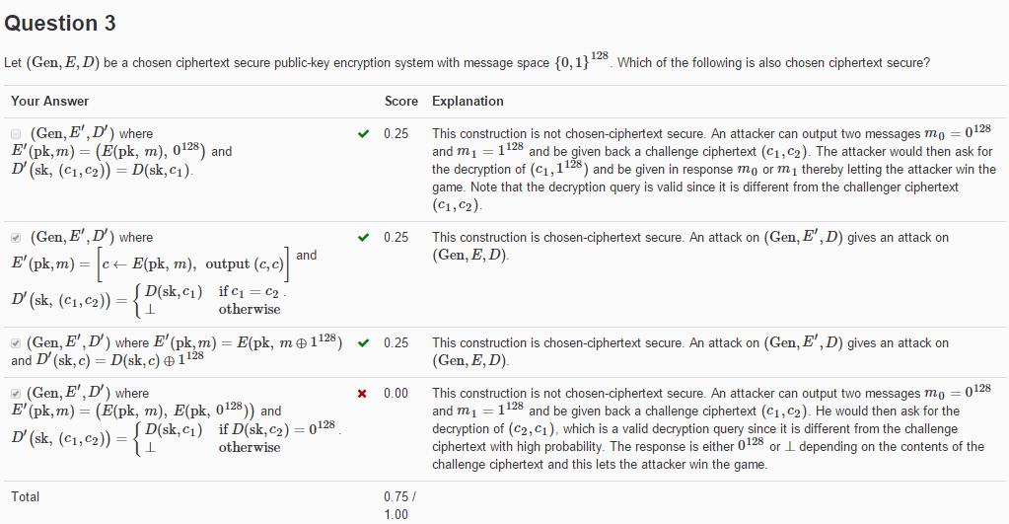
Question 3
解析：

Slide 5
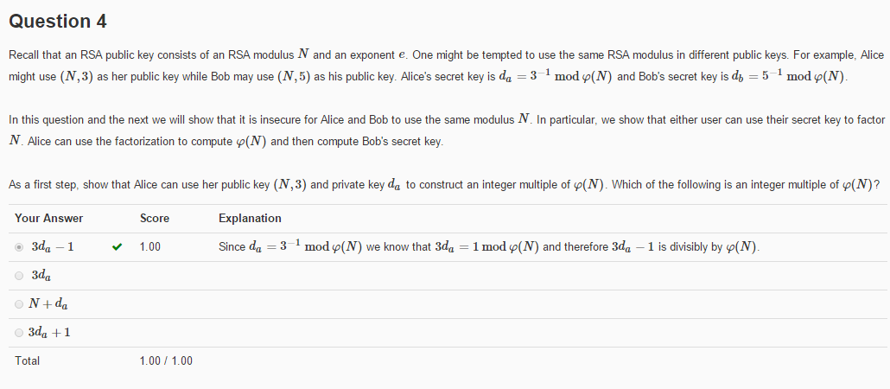

__L1n__w@tch
Question 4
解析：
利用性质：$\begin{matrix}\left.e·d=1(mod(φ(N))\right) \\ e·d=kφ(N)+1 \\ \end{matrix}$这道题里，e为公钥3，d为私钥d_{a}

Slide 6
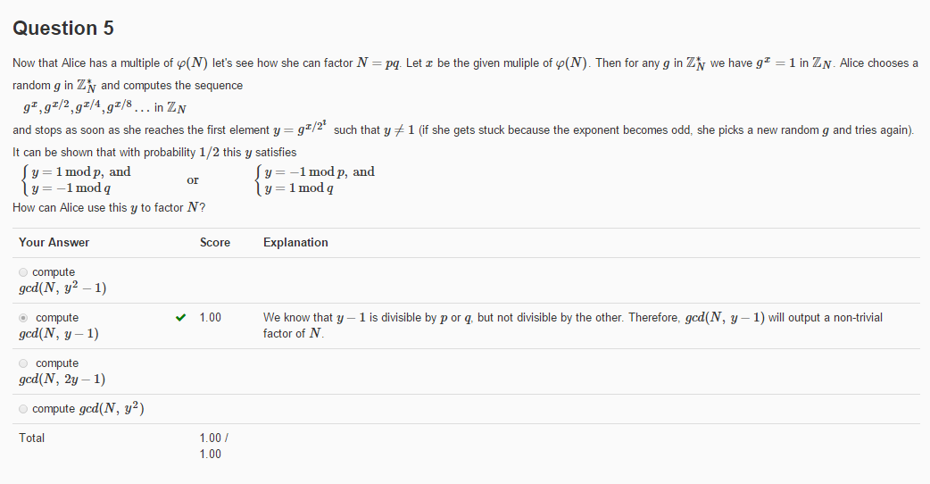
思路
__L1n__w@tch
Question 5
解析：
这里得分开来看，如果是左边的情况y-1就会被p整除，右边的情况y-1会被q整除
letting p = gcd(N, y-1) and q = N/p.

Slide 7
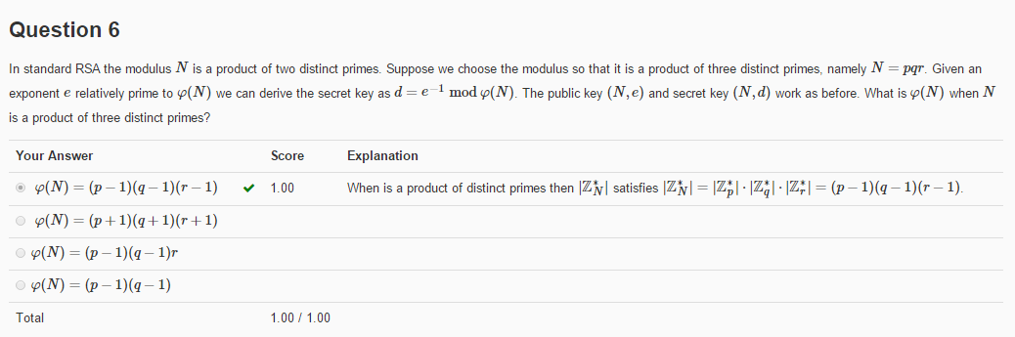
Question 6
解析：
The totient function is multiplicative, so
phi(N)
= phi(pqr)
= phi(p)phi(q)phi(r)
= (p-1)(q-1)(r-1)
这题用排除法吧，把qr当成一个来看，带进去，就比较一下什么情况有可能得到(qr-1)这个东西

Slide 8
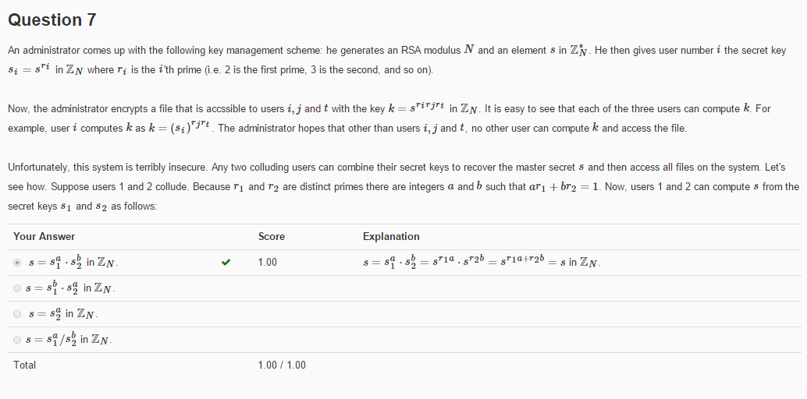
__L1n__w@tch
Question 7
解析：利用ar1 + br2 = 1, 两边同时取指数，即s^(ar1 + br2) = s^1，算一下就得到上面那货了
We can compute s1^a * s2^b = s^(ar1) * s^(br2) = s^(ar1 + br2) = s^1 = s

Slide 9
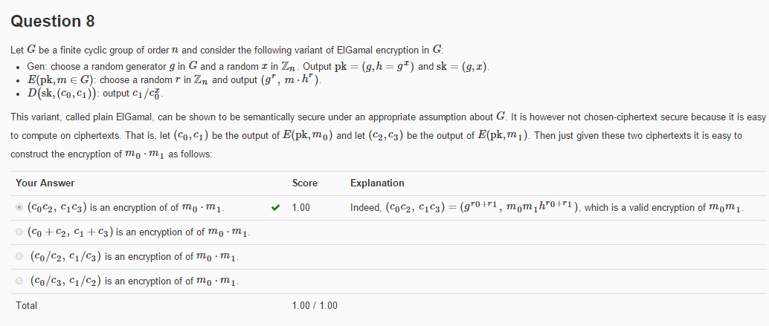
Question 8
__L1n__w@tch
解析：The attacker asks for the encryption of m0 and m1, which are
E(pk,m0) = (c0,c1) = (g^r, m0*g^xr) for random r
and
E(pk,m1) = (c2,c3) = (g^r, m1*g^xr) for random r
He wishes to compute
E(pk,m0*m1) = (g^r, m0*m1*g^xr) for random r
He can compute this value by picking a random r in Zn, then computing
(c0*c2, c1*c3) = (g^(r1+r2), m0*m1*h^(r1+r2))

Slide 10
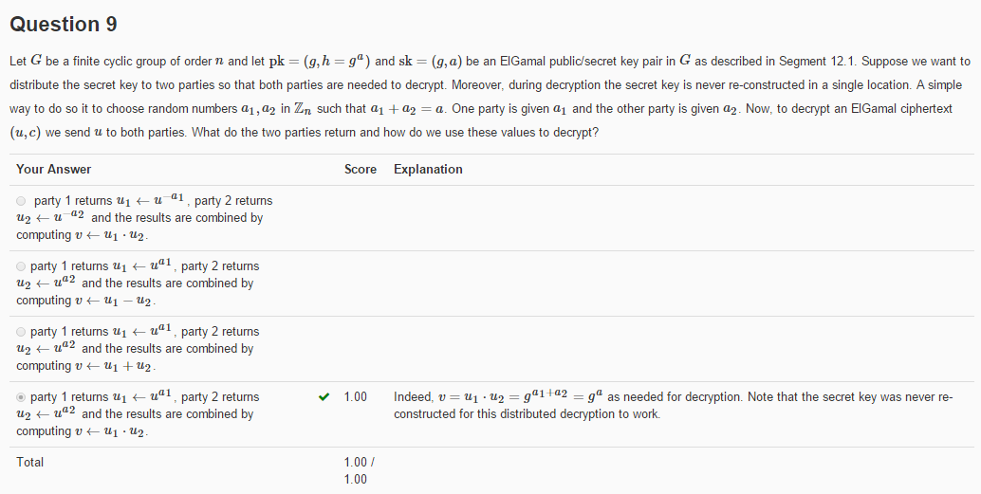
Question 9
__L1n__w@tch
解析：If a1 + a2 = a, then we can can share the computation of v by recognizing that
v = u^a = u^(a1 + a2) = u^a1 * u^a2.
So party 1 computes u1 = u^a1, party 2 computes u2 = u^a2, and the results are
combined using v = u1 * u2.

Slide 11
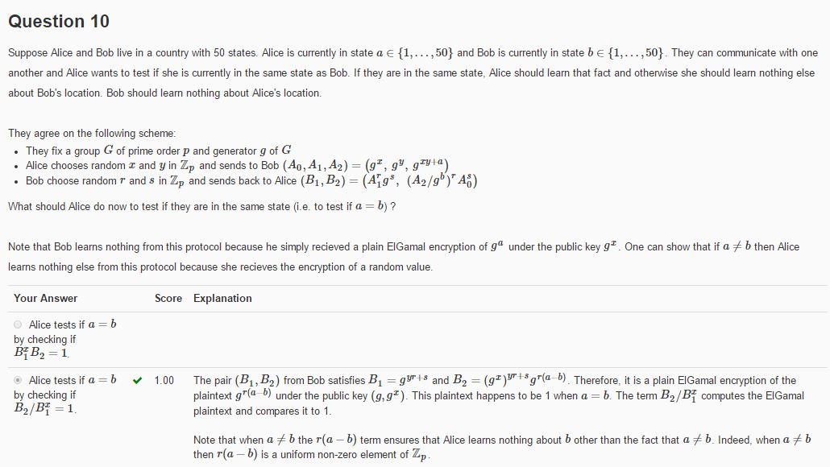
Question 10
__L1n__w@tch
解析：Since B2 = (A2/g^b)^r * A0^s and A2 = g^(xy + a),
B1 = (A1^r * g^s) = g^(yr+s)
B2 = (A2/g^b)^r * A0^s = g^(r(xy+a-b) + sx)
So considering the exponents
B1^x = rxy + sx
B2 = rxy + (ra - rb) + sx
If a == b then
B2/B1^x = rxy + (0) + sx - rxy - sx = 0 in the exponent
So she checks that B2/B1^x == 1
一个一个算呗
B_1^x B_2=1−−>g_1^yγx g^sx·(g^(xy+a)/g^b )^γ g^xs
其实算了第一个之后就可以发现答案了

Slide 12
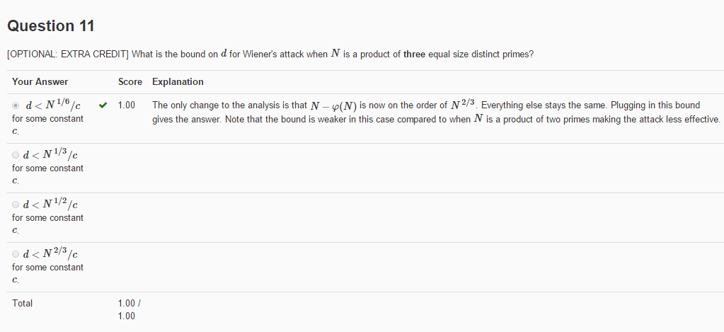
__L1n__w@tch
Question 11
解析：
In the proof of the bounds on Wiener's attack where N=pq, we found that
|N - phi(N)| <= p+q <= 3 sqrt(N)
When N is product of 3 primes p,q,r we see that
phi(N) = pqr - pq - pr - qr + p + q + r - 1
|N - phi(N)| <= 4*N^(2/3)
Nothing else in the proof changes, so we require d <= N^(1/6)/c

Slide 13
__L1n__w@tch
In the end
T
H
A
N
K
Y
0
U

